Slide 1

Predictive Modeling for Income Evaluation
Uncovering Socio-Economic Dynamics and Employment Characteristics
Prepared by: Miral Naik

Slide 2
Index
Problem Statement
Dataset Overview
Exploratory Data Analysis & Visualization
Data Preprocessing & Feature Engineering
Model Building
Results & Insights

Slide 3
Problem Statement

Slide 4
I have information about people’s incomes from various countries. My goal is to use this data to create a model that can predict whether someone earns more than $50K.
By building this model, I want to figure out what factors make people earn more money. This could help us understand the reasons behind financial success in different places and among different groups of people.
The information I gather could be really useful for people who make decisions about policies, for researchers, and for anyone curious about what makes some people earn more than others.

Slide 5
Dataset Overview

Slide 6
There are 32,561 records and 16 features in the dataset.
The features include Age, Profession class, Final census, Education, Education-num, Marital status, Occupation, Relationship, Race, Gender, Capital gain, Capital loss, Hours per week, Country, and Income.
The data types of the columns are integers (int64) and objects.
Integers are used for numerical information such as Age, Final census, Education-num, Capital gain, Capital loss, and Hours per week.
Objects are used for categorical information such as Profession class, Education, Marital status, Occupation, Relationship, Race, Gender, Country, and Income.
There is a column named ‘unnamed:15’ which has only 2 values so dropped it from the dataset. Also checked and removed 24 duplicate values from the dataset.

Slide 7
Overview of the features
Age: The age of the individuals.
Profession Class: The class or category of the profession.
Final Census: A numerical value related to the final census.
Education: The level of education attained.
Education-num: The numerical representation of education.
Marital Status: The marital status of the individuals.
Occupation: The type of job or occupation.
Relationship: The relationship status of the individuals.
Race: The racial background of the individuals.
Gender: The gender of the individuals.
Capital Gain: Amount gained through investments or capital.
Capital Loss: Amount lost through investments or capital.
Hours-per-week: The number of hours worked per week.
Country: The country of residence.
Income: The target variable indicates whether the income exceeds $50,000.

Slide 8
Exploratory Data Analysis & Visualization

Slide 9
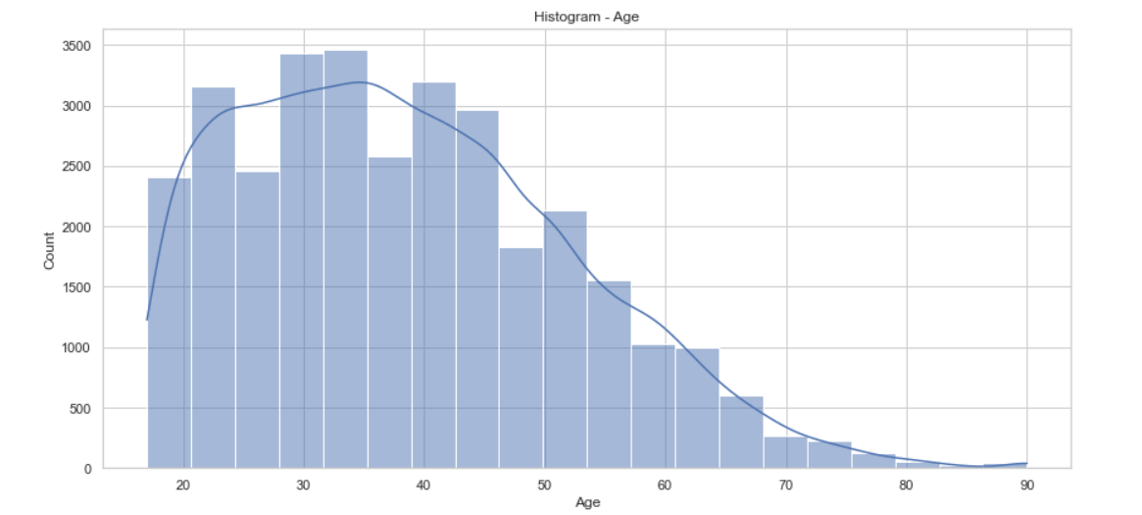
Age
Data has the right skewness, with the majority of the Ages falling in the 20–50.
The count keeps on decreasing as the Age increases.

Slide 10
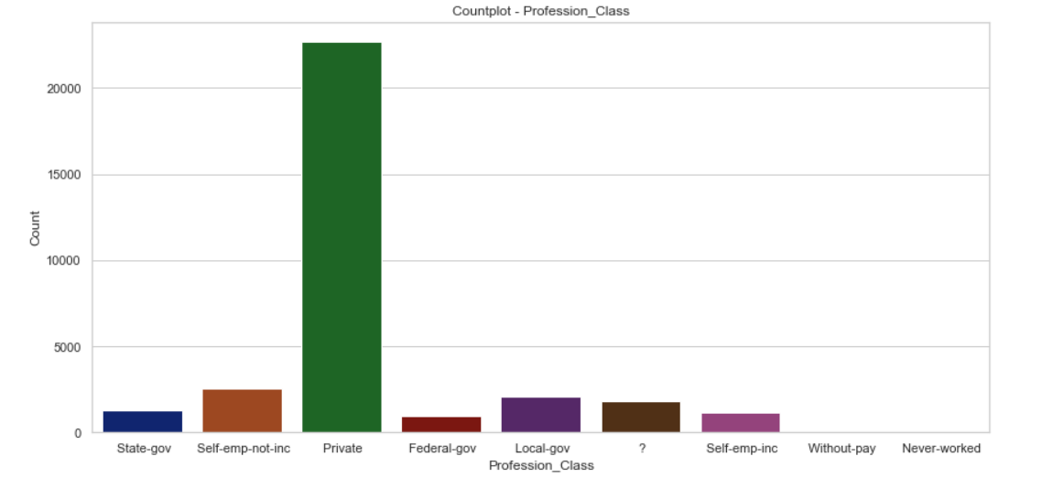
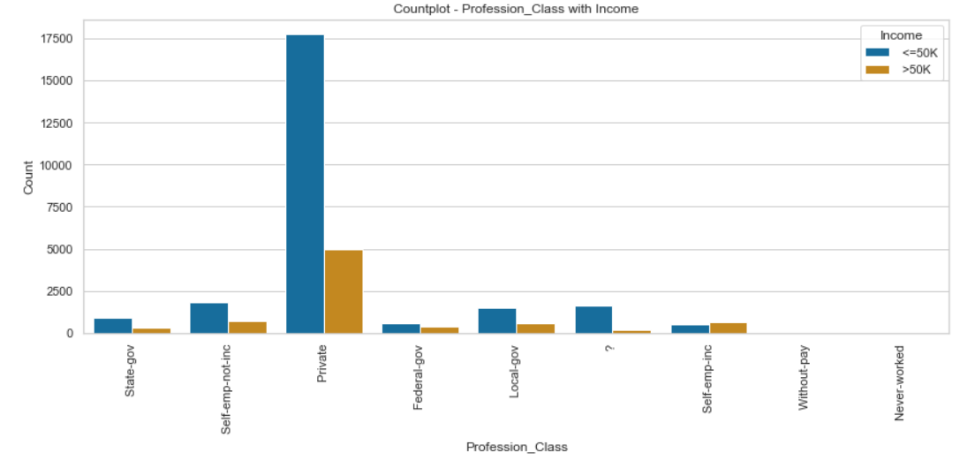
Profession_Class
Profession_Class with Income
Majority of the people belong to the ‘Private’ sector Profession_Class.
The missing values of Profession_Class are 1836 and values represented by ‘?’
Ratio of people earning more than 50K is higher in case Profession_Class is ‘Self-emp-inc’

Slide 11
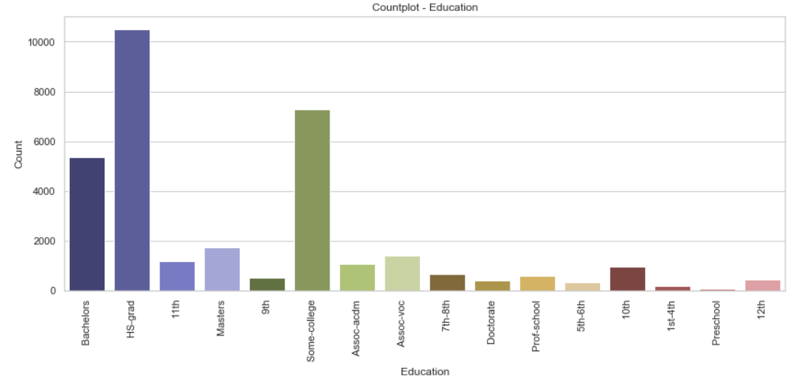
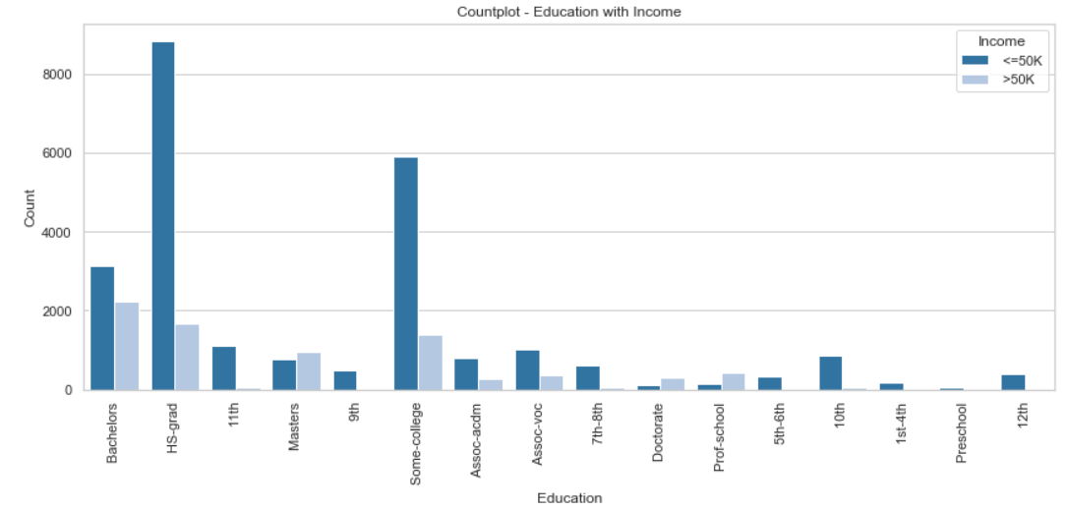
Education
Education with Income
Majority of the people have education level as ‘HS-grad’, followed by ‘Some-college’ and ‘Bachelors’.
People with education level as ‘Masters/Doctorate/Prof-school’ have higher ratios of >50K earning, than <=50K.

Slide 12
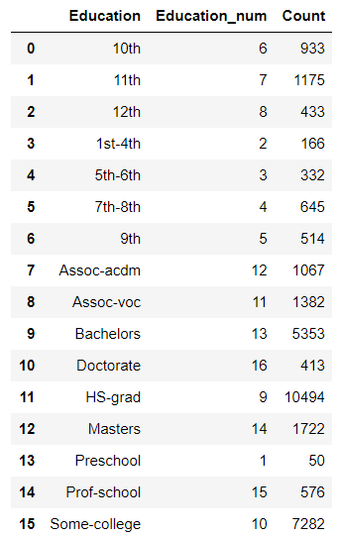
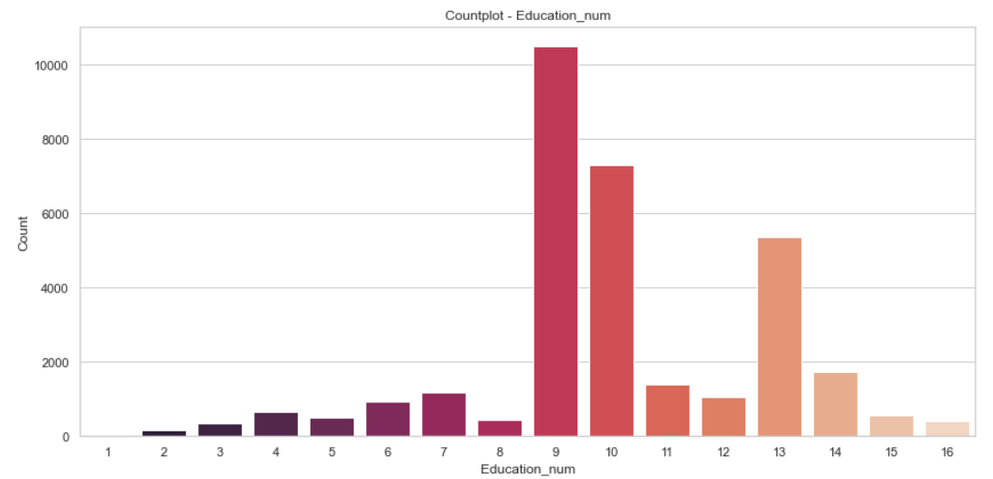
Education_num
The count of the ‘Education’ column and ‘Education_num’ is the same. This means the ‘Education_num’ column provides the same information as the ‘Education’ column but in a numeric manner.

Slide 13
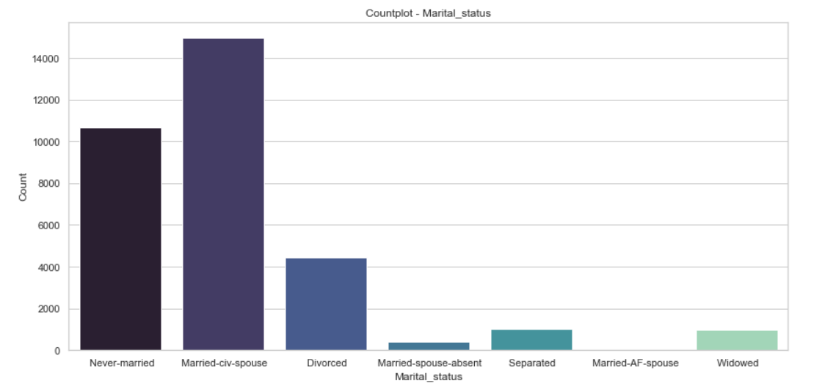
Marital_status
Majority of the people have ‘Marital_Status’ as ‘Married-civ-spouse’, and least have ‘Married-AF-spouse’.
The count of ‘Never-married’ is also quite high.

Slide 14
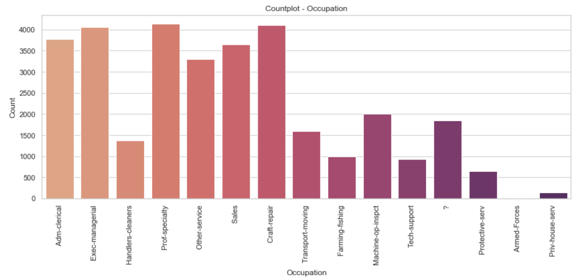
Occupation
Majority of the people have "Prof-specialty", "Craft-repair", and "Exec-managerial" Occupation.
The missing values of Occupation are 1843 and values represented by ‘?’

Slide 15
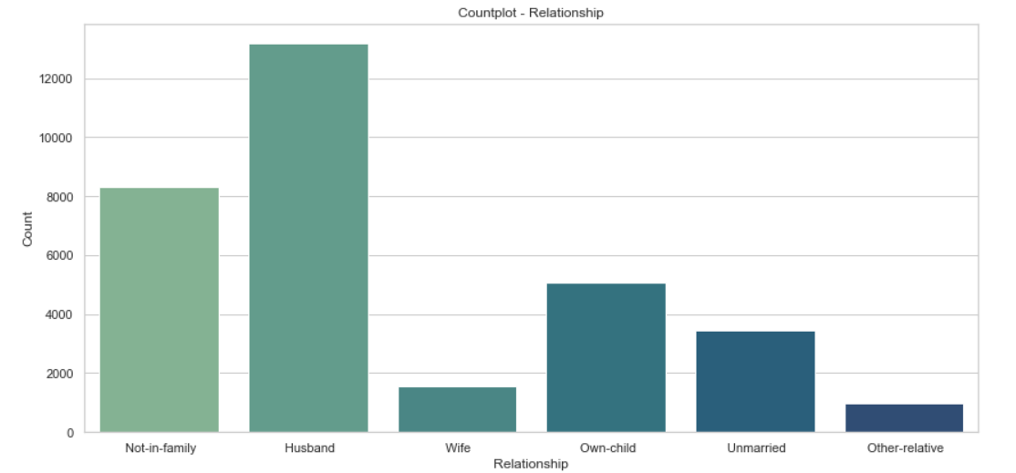
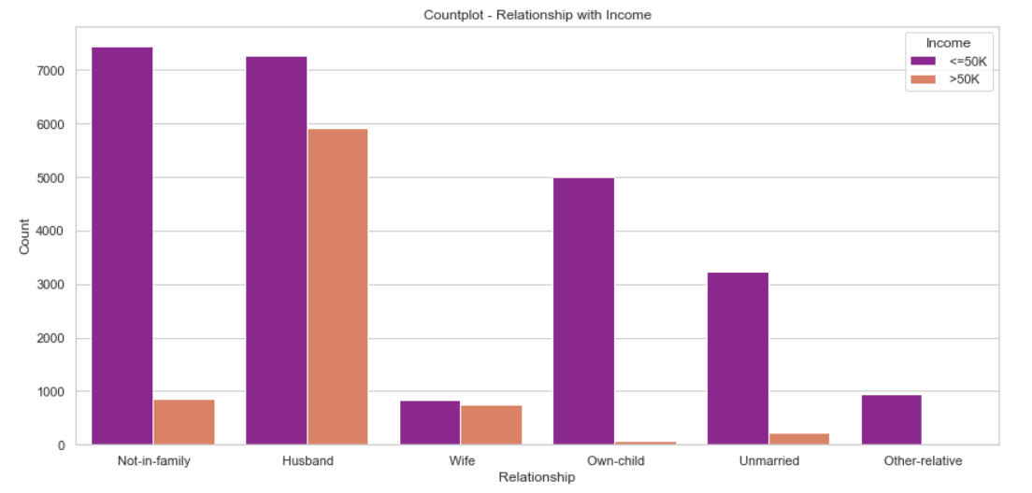
Relationship
Relationship with Income
The highest number for ‘Husband’ and lowest for ‘Other-relative’.
If the relationship in the family is either ‘Husband/Wife’, the chances of earning more than 50K is high.

Slide 16
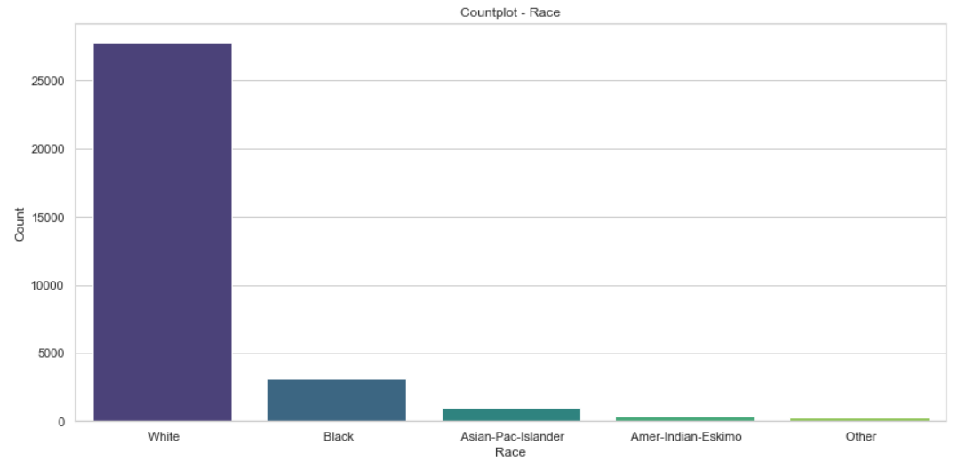
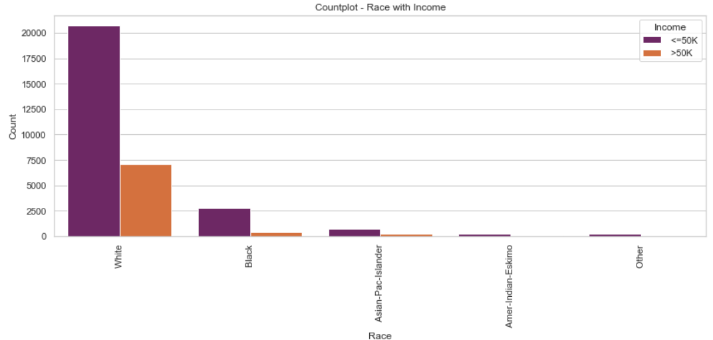
Race
Race with Income
The highest number of people have race as ‘White’
A person has a high chance of earning >50K in case his/her race is ‘White’.

Slide 17
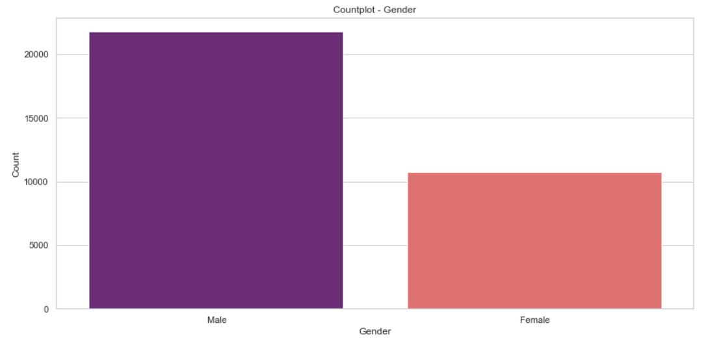
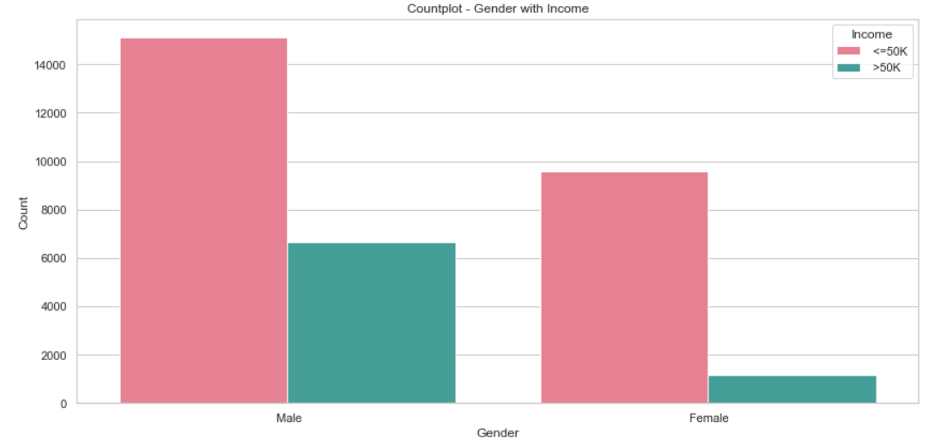
Gender
Gender with Income
Number of males is almost double to number of females.
Males have a higher chance of earning more than 50K, than females.

Slide 18
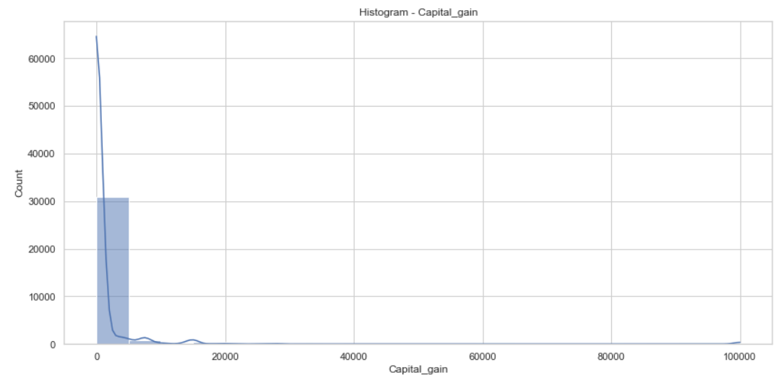
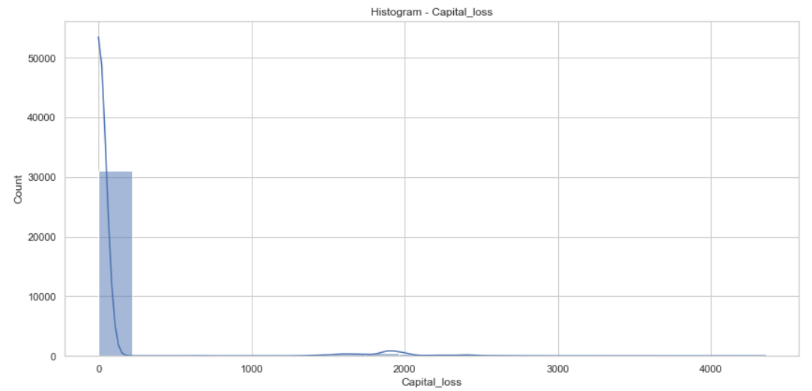
Capital_gain
Capital_loss
Majority of the values set as 0.
The distribution plot for the ‘Capital_gain’ column is highly right-skewed.
Majority of the values set as 0.
The distribution plot for the ‘Capital_loss’ column is highly right-skewed.

Slide 19
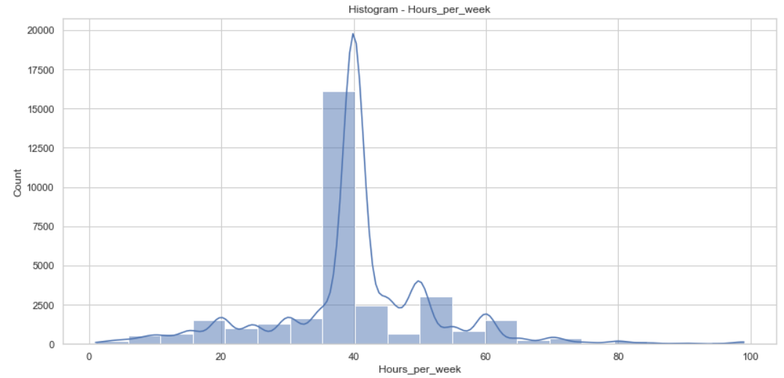
Hours_per_week
Majority of the values have data near 40 hours.

Slide 20
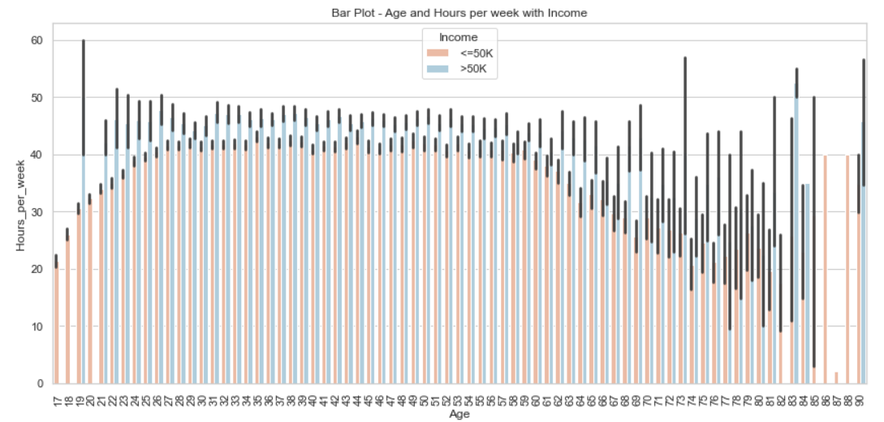
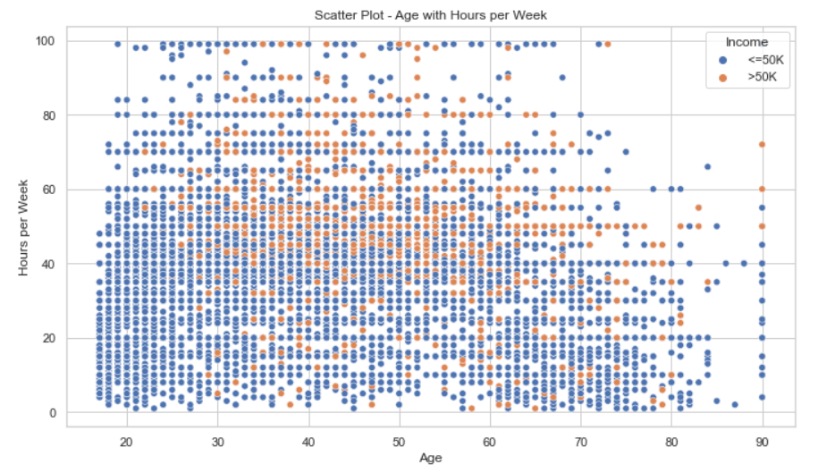
Age and Hours_per_week with Income
A person needs to be >30 to be earning more than 50K, else needs to work at least 60 hours_per_week to earn >50K.

Slide 21
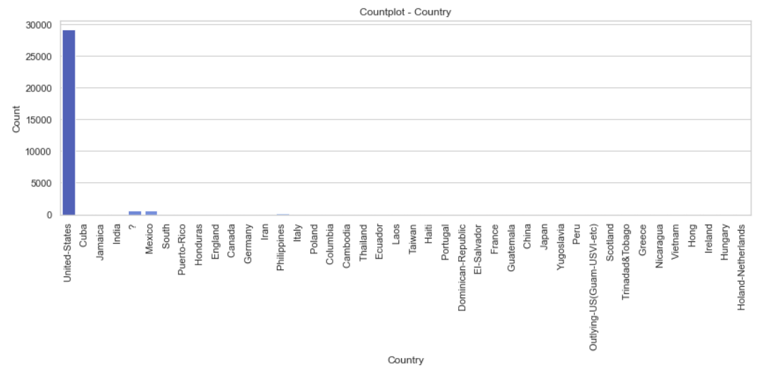
Country
The highest count is set to ‘United States’, and the rest of the rows contain quite a few numbers.
The missing values of Occupation are 582 and values represented by ‘?’

Slide 22
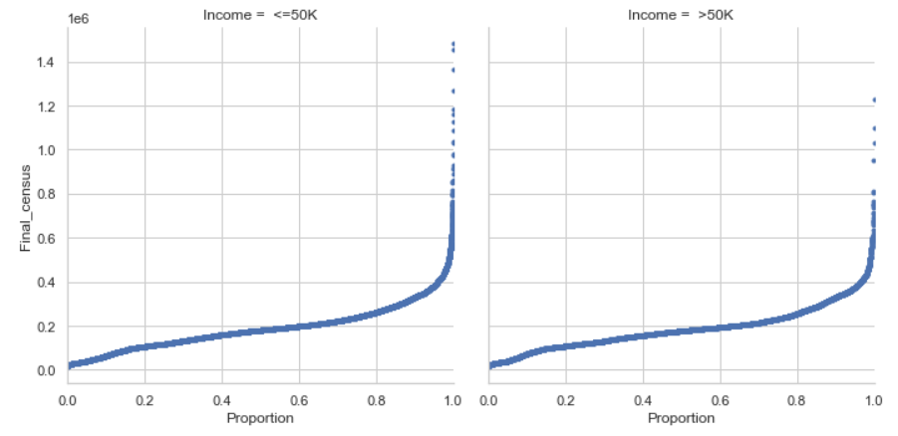
Final_census
Here we can see both the low and high-income groups have the same distribution so this feature won’t provide much discriminatory information for distinguishing between the two income groups. So we can drop it.

Slide 23
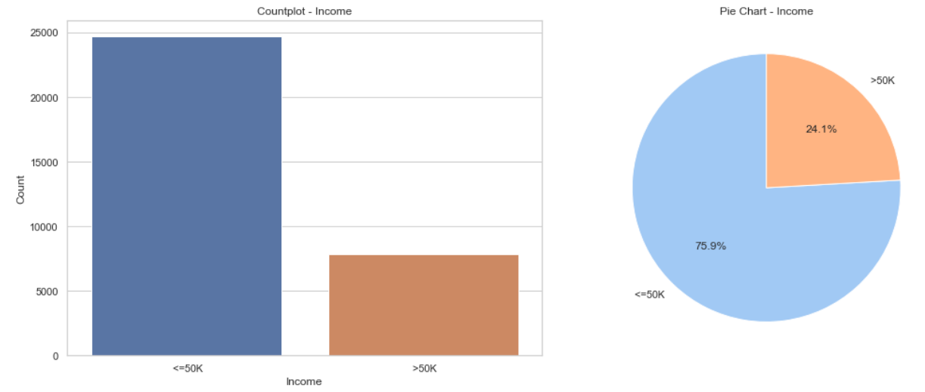
Income
The "Income" column is our target variable which has two values "<= 50K and > 50K"
The number of rows with income <= 50K is 24698 and the Number of rows with income > 50K is 7839
The people with income higher than 50K are significantly less.
The dataset is imbalanced.

Slide 24
Data Preprocessing & Feature Engineering

Slide 25
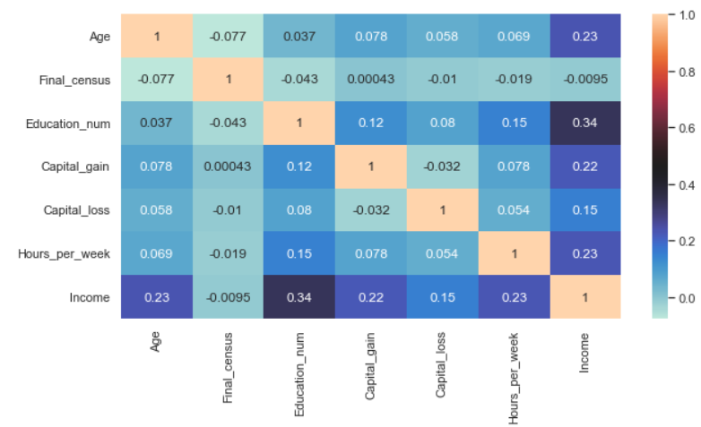
Correlation for Numerical data using Heatmap
Income has a 34% correlation with ‘Education_num’, 23% with ‘hours_per_week’ and ‘age’, and 22% with ‘Capital_gain’.
So the correlations are moderate.
I have also checked the correlation between categorical columns using the Chi-square test and found no major correlation.

Slide 26
Missing Value Treatment
'Profession_Class' had 1836 missing values, 'Occupation' had 1843 missing values, and 'Country' had 582 missing values.
This imputation process, where missing values were filled with the mode (most frequent value) of their respective columns. This ensures the dataset is more comprehensive and ready for analysis.
Handling Outliers
There are a huge amount of outliers present in our data. It will make an impact on model prediction so we have to handle these outliers.
I have used the IQR method as well as the Z-score method to find the number of outliers and our dataset is already imbalanced, losing this number of rows with further increase the imbalance, and would be a significant loss if we consider the rows with income higher than 50K dollars.
We can not afford to lose this much of data. So I have tried different thresholds to get an idea of how much data we will lose and when I used 4.2 as the threshold value in the Z-score method we lost only 7% of the data.
So I have used the Z-score method to handle the outliers.

Slide 27
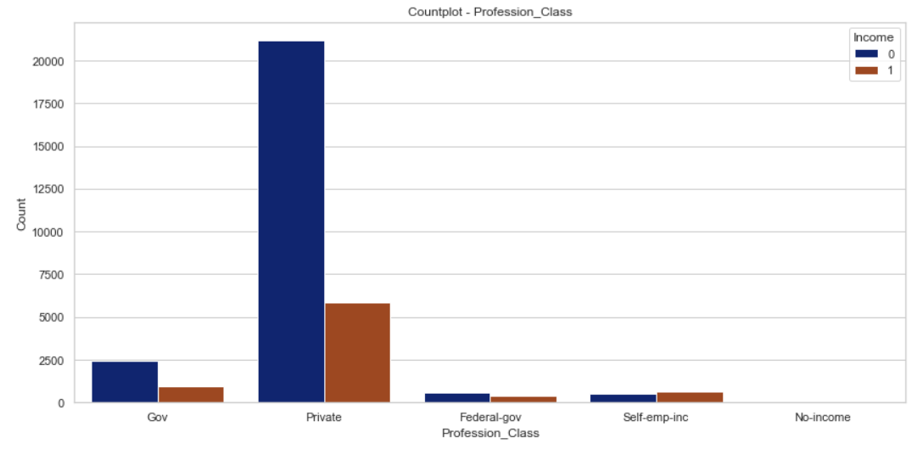
Feature Engineering
Profession_Class
I have put ‘Never-worked’ and ‘Without-pay’ in one category as No-income, classify ‘State-gov’ and ‘Local-gov’ as ‘Gov’, and we add the ‘Self-emp-not-inc’ in the ‘Private’ category since the distributions are similar.
Now I obtained 5 different categories in the Profession_Class column.

Slide 28
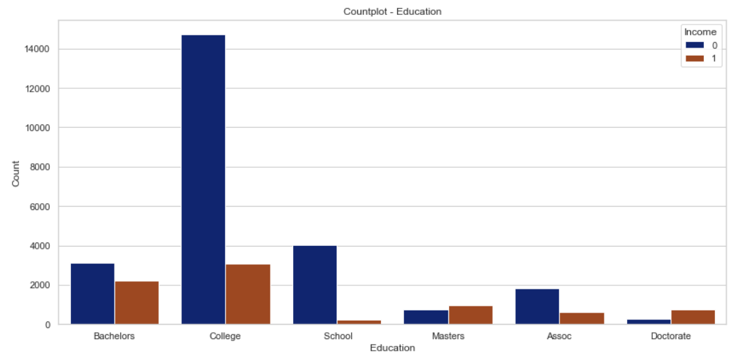
Education
I have combined all the columns relevant to schools in the ‘School’ category, put ‘Doctorate’ and ‘Prof school’ in a single category ‘Doctorate’, ‘Assoc-acdm’ and ‘Assoc-voc’ in one category ‘Assoc’, and ‘HS-Grad’ and ‘Some-college’ in one category ‘College’.
Now I obtained 6 categories of education

Slide 29
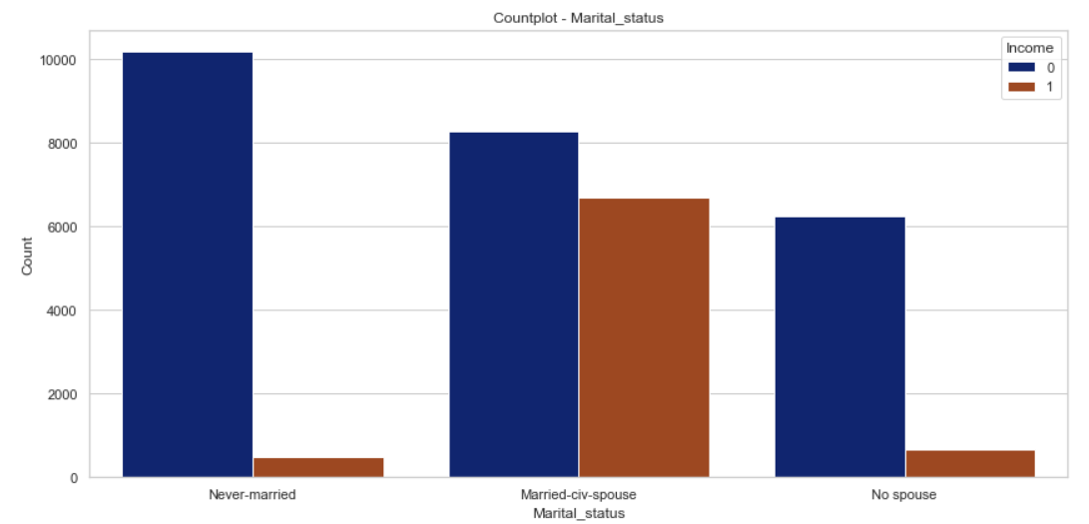
Marital_status
I have combined ‘Divorced’, ‘Married-spouse-absent’, ‘Separated’, ‘Widowed’ and ‘Married-AF-Spouse’ to one category and named it as ‘No spouse’.
Now I obtained 3 categories.

Slide 30
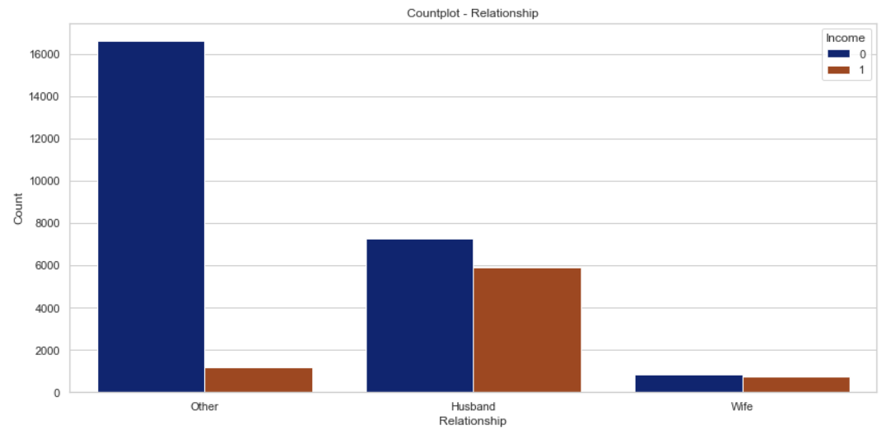
Relationship
I have combined the ‘Not-in-family’, ‘Own-child’, ‘Unmarried’ and ‘Other-relative’ columns to a single category looking at the distributions, and the name is as ‘Other’.
Now I obtained 3 categories.

Slide 31
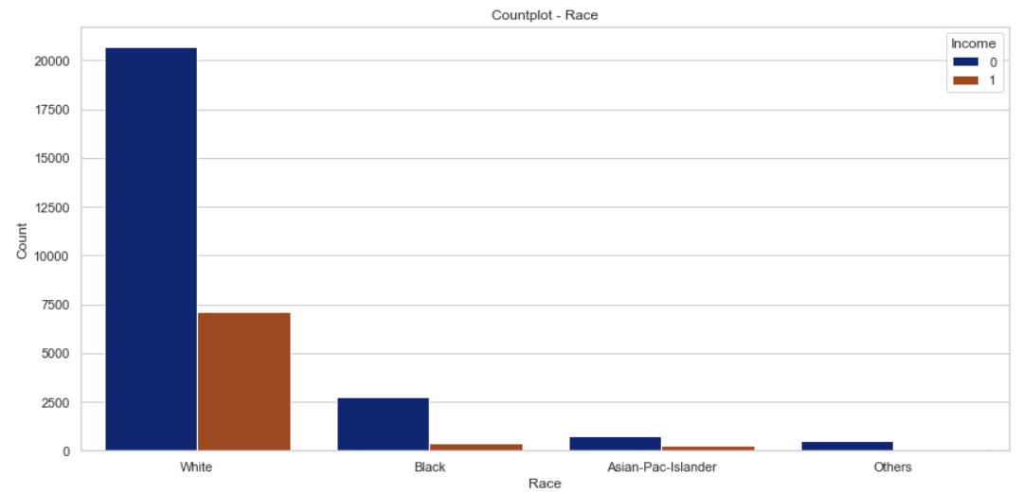
Race
I have combined the categories ‘Amer-Indian-Eskimo’ and ‘Other’ into the ‘Others’ category since they have similar distributions.

Slide 32
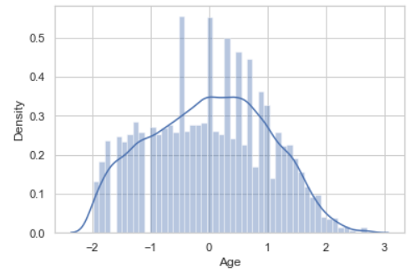
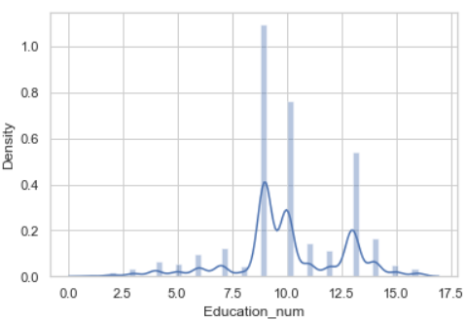
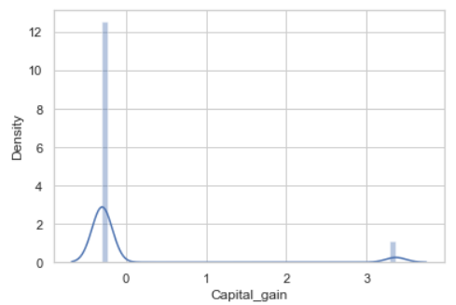
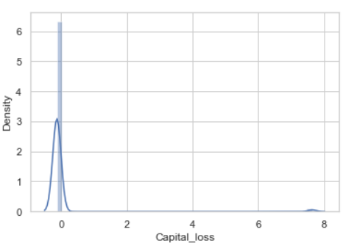
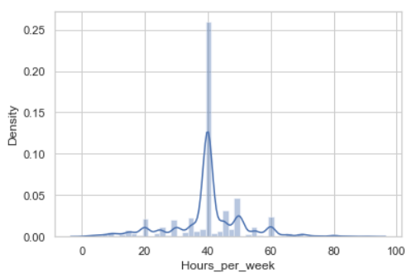
Encoding Part
The categorical columns 'Profession_Class', 'Education', 'Marital_status', 'Occupation', 'Relationship', 'Race', 'Gender', and 'Country’ are transformed into numerical columns separately using the LabelEncoder.
The LabelEncoder assigns a unique numerical label to each category within each column, thereby converting categorical data into a format suitable for Machine Learning models requiring numerical input.
Skewness treatment
To preprocess numerical columns ('Age', 'Education_num', 'Capital_gain', 'Capital_loss', 'Hours_per_week’) by applying a power transformation to reduce skewness, and it provides visualizations to assess the effectiveness of the transformation.
A lot of skewness has been reduced but we cannot remove skewness more than this.

Slide 33
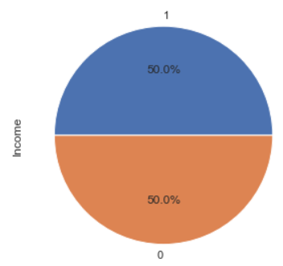
Scaling the Data(StandardScaler)
Standardization is a common preprocessing step that ensures all features have a mean of 0 and a standard deviation of 1, which can be important for certain machine learning algorithms that are sensitive to the scale of the input features.
Handling Imbalance Data
Imbalanced datasets, where one class is significantly underrepresented compared to another, can pose challenges for machine learning models, especially in classification problems. Class imbalance can lead to biased models that perform poorly on the minority class (<50k - 75.9%, >50k - 24.1%)
I used SMOTE (synthetic minority oversampling technique) over the under-sampling technique (near miss) because I got better results in terms of model performance
It will take random samples from <50k values and make the duplicates till they both have the same proportion.
Data is balanced now, both the category of income have 50% data each.

Slide 34
Model Building

Slide 35
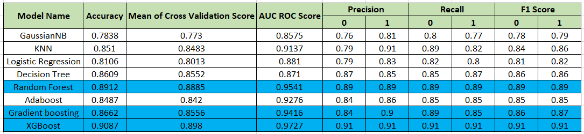
I have Split the data into test and train in a 25:75 ratio
For choosing the base model I have used all the classification models such as GaussianNB, KNN, Logistic regression, Decision Tree, Random Forest, AdaBoost, gradient boosting and XGboost.
I Checked their performance by different metrics AUC ROC Score, Confusion matrix, Precision, Recall, and F1-score also used the cross-validation method to check the mean value of the cross-validation score.

Slide 36
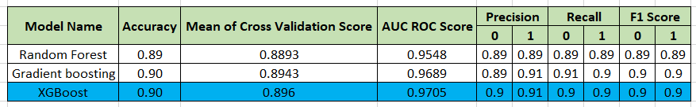
Random Forest, Gradient Boost, and Xtreme Gradient Boost give us the best performance, so I further try hyperparameter tuning on them to get the best parameters for these three models so that I can choose the final model.
I have used the Grid search CV method to get the best parameters for the base models.
Again, I checked all performance metrics AUC ROC Score, Confusion matrix, Precision, Recall, F1-score, Mean of cross validation score.
XGBoost Performed marginally well compared to the Gradient boosting classifier and gave the best results for this classification problem.

Slide 37
Results & Insights

Slide 38
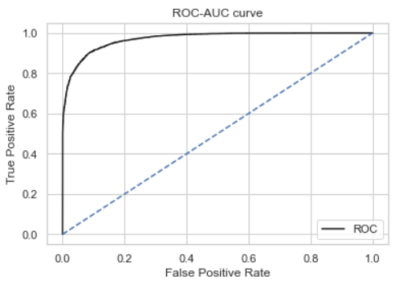
Result
XGboost and Gradient Boost have almost the same accuracy (0.90), followed by Random Forest (0.89).
XGboost has the highest AUC-ROC score (0.9705), followed by Gradient boosting (0.9689) and Random Forest (0.9548).
Both accuracy and AUC-ROC scores are higher for Gradient boosting and XGboost compared to Random Forest.
XGBoost consistently performs slightly better than Gradient boosting in terms of both accuracy and AUC-ROC score.
Based on all the metrics, XGboost Classifier appears to be the best-performing model among the three for predicting income levels.

Slide 39
Insights
People with education level as ‘Masters/Doctorate/Prof-school’ have higher ratios of >50K earning, than <=50K.
If the relationship in the family is either ‘Husband/Wife’, the chances of earning more than 50K are high.
A person has a high chance of earning >50K if his/her race is ‘White’.
Males have a higher chance of earning more than 50K, than females.
A person needs to be >30 to earn more than 50K, or work at least 60 hours per week to earn >50K.
This income evaluation prediction ML model can be used for various statistical purposes –
Predict whether People can be given loans or other benefits according to their income.
Assigning scores to People to give them credibility by using the best features related to income.
These scores can be utilized to create different categories of Census-
1. Old age, High income, Highly educated.
2. Middle-aged, Middle-income, Average educated.
3. Young, Low income, Low educated.

Slide 40
Thank You!

